Slide 1
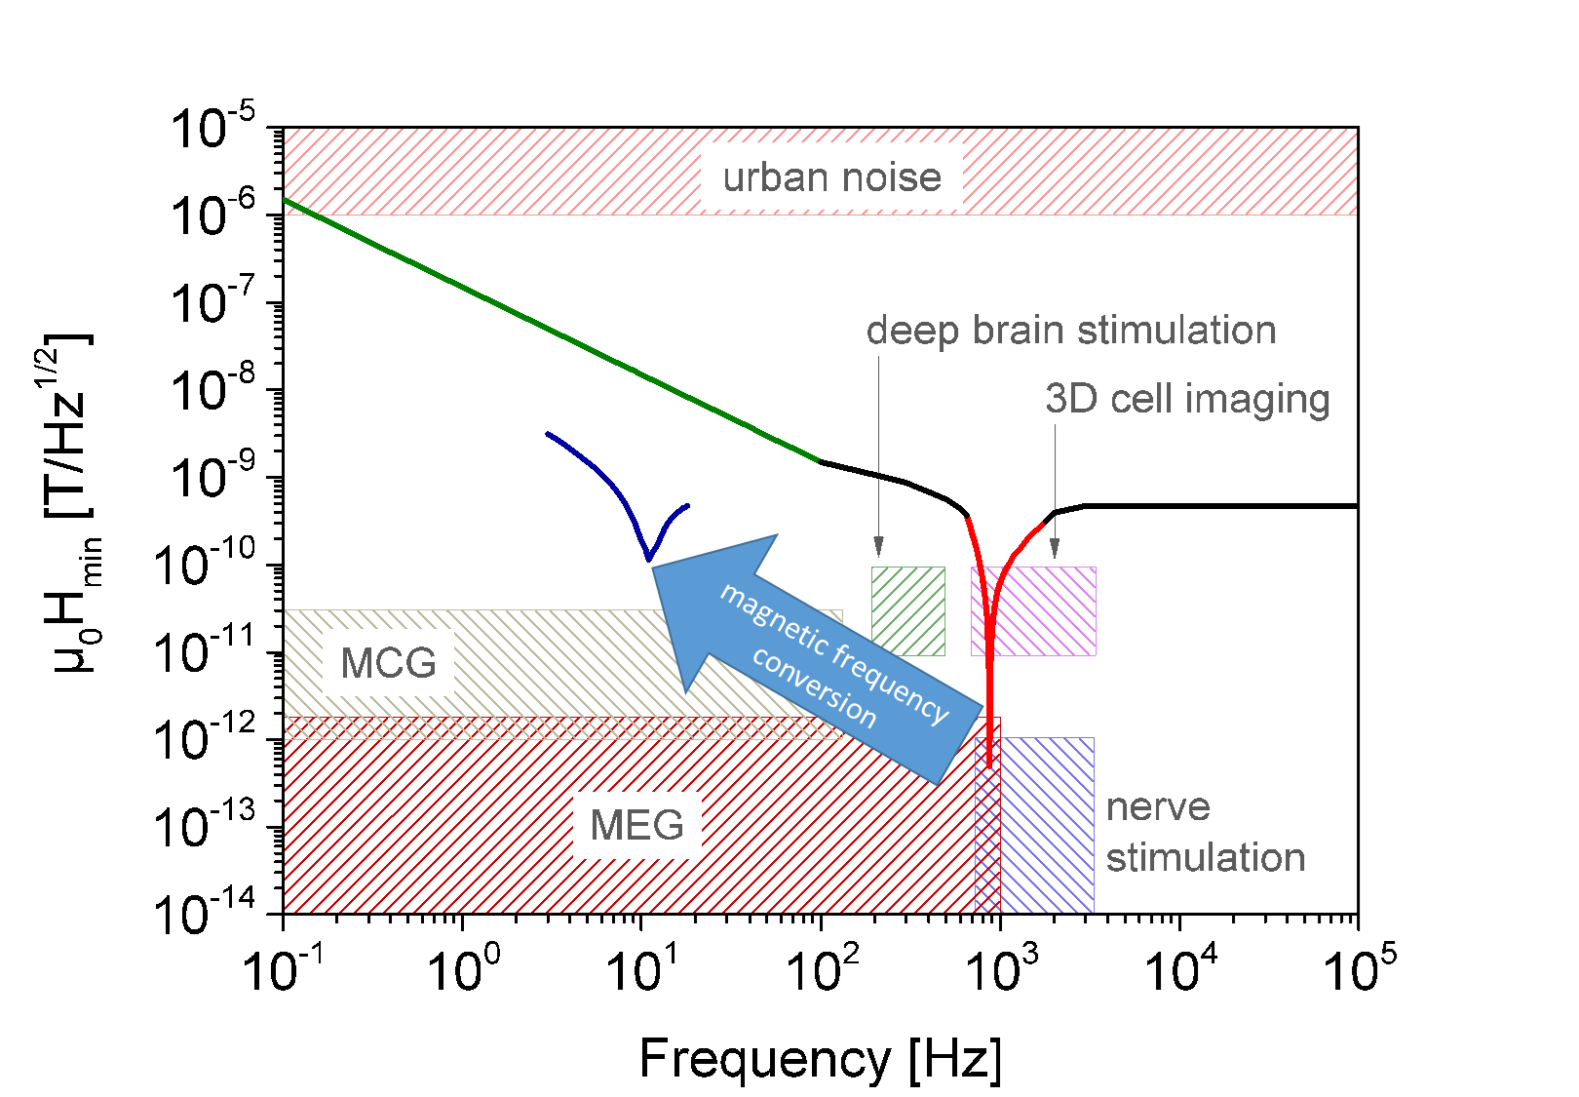
A1
Title of the Poster
Contributing Authors
Topic
Present limitations in low frequency measurements
magnetic frequency conversion
crosstalk
size
power consumption
frequency limitation
magnetic noise
direct measurements: 1/f noise
resonance at low frequencies:
technological difficult
extremely small bandwidth
Next Topic
Main headline
Next Topic
Some text
Project Progress
Main headline
Some text
 |  | 2020 |  | 2021 |  |  |  | 2022 |  |  |  | 2023 |  |  |  | 2024
 |  | 3 | 4 | 1 | 2 | 3 | 4 | 1 | 2 | 3 | 4 | 1 | 2 | 3 | 4 | 1 | 2
WP 1 | Keywords | 100%
WP 2 | Keywords |  |  | 90 %
WP 3 | Keywords |  |  |  |  |  |  | 40 %
WP 3 | Keywords |  |  |  |  |  |  |  |  |  |  | 0 %
Please create a table similar to the one above with your project progress.
Publications
Please list all publications created in your project since July 2020.

